Slide 1
Writing Algorithms
Introduction to Python

Slide 2
Learning Objectives
Learn to write algorithms in pseudocode
Create programs from pseudocode/algorithms
Detect and correct syntax errors

Slide 3
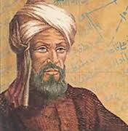
Define Algorithm
The word comes from Al-Khwarizmi (9th century mathematician)
Algorithm - a set of steps that defines how a task is performed (step by step).
Cooking – Recipes
Finding you way – Directions
Computers – Boot Sequence

Slide 4
What does this algorithm do?
#GhostHunter
if ghost catches man then
lives ← lives – 1
if lives = 0 then
display "Game Over!"
else
display "Arghhh!"

Slide 5
Writing Pseudocode
Pseudocode is half code, half English
It has no real syntax and would not run
It is a structured sequence of instructions
It is useful for planning algorithms
Use it to plan before coding!

Slide 6
Suggested language for Pseudocode
Use indentation in pseudocode
Use words such as:
print, display, show, read, obtain, get, input, output, calculate, add, set, reset, if, then, else, set, init, increment, decrement

Slide 7
Pseudocode Example:
if unlock button pressed then
display PIN unlock screen
input PIN
if correct PIN entered then
unlock phone
else display “Try again”
else display lock screen

Slide 8
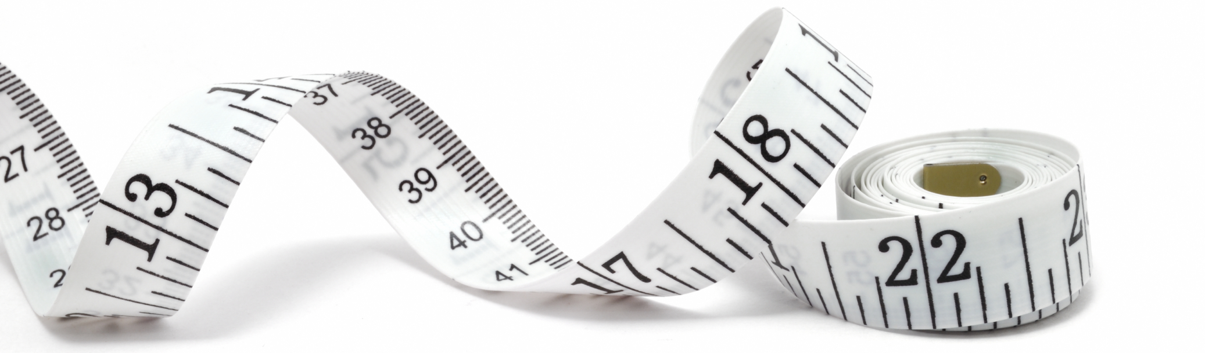
Writing an Algorithm
Write a pseudocode algorithm to display the correct hat size based on the circumference of your head:
Less than 57cm = Small
Greater than 60cm = Large
Anything in between = Medium

Slide 9

Now write the code…
You should understand the problem more clearly
It should be easier to write – in any language!

Slide 10

A Type of programming error
Syntax Errors
Rules of the language are broken
E.g. Spelling mistake , incorrect functions used , missing out a :

Slide 11
Debugging exercise
Look at the program in your folder called SeasonFinderBUGS.py
Your Task is to see if you can find and correct the syntax errors.

Slide 12
Pseudocode Tasks
Complete the following:
  Python Worksheet Algorithms
  Pseudocode Task
  Use the Pseudocode Command sheet to help you

